Slide 1
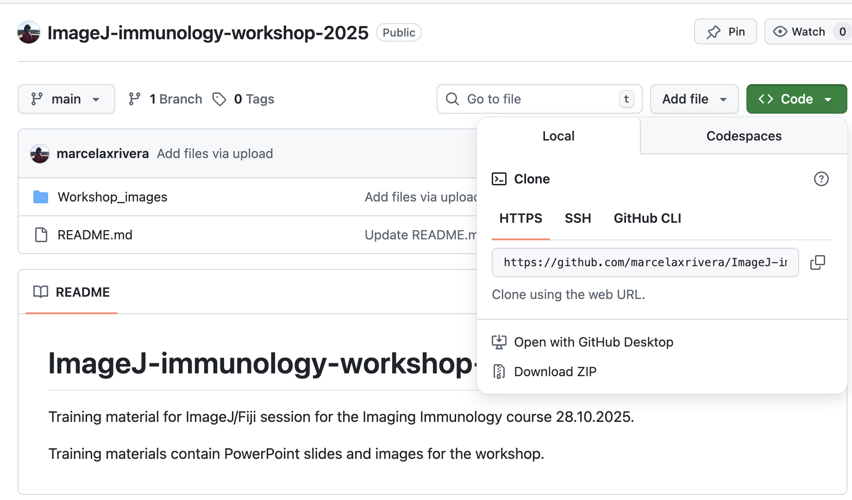


WELCOME!
Please install Fiji:
https://fiji.sc/
Please download materials from GitHub: https://github.com/marcelaxrivera/ImageJ-immunology-workshop-2025/

Slide 2
Marcela Rivera marcela.rivera@abo.fi Imaging in immunology course 2025
28.10.2025
Image analysis using FIJI
Includes materials from Guillaume Jacquemet, Peter Bankhead, Elnaz Fazeli, Joanna Pylvänäinen

Slide 3
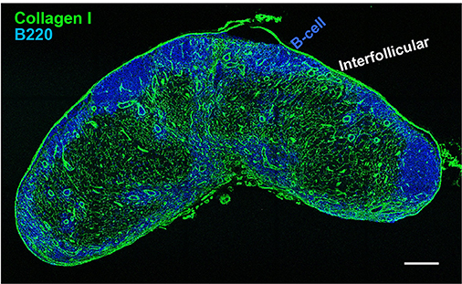
Image analysis in immunology
Localization of immune cells
Cross section of human lymph node
(Louie, D. A. P., & Liao, S. 2019)

Slide 4
Image analysis in immunology
Localization of immune cells
Cross section of human lymph node
(Louie, D. A. P., & Liao, S. 2019)

Slide 5
Image analysis in immunology
Localization of immune cells
Cross section of human lymph node
Quantitative measurements:
Total area
Distribution/ Location
color image → grayscale → binary mask → measurement
(Louie, D. A. P., & Liao, S. 2019)

Slide 6
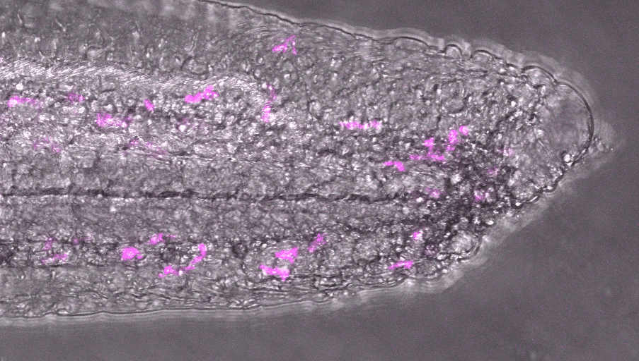
Image analysis in immunology
Immune cell trafficking in zebrafish tail
Ilkka Paatero

Slide 7
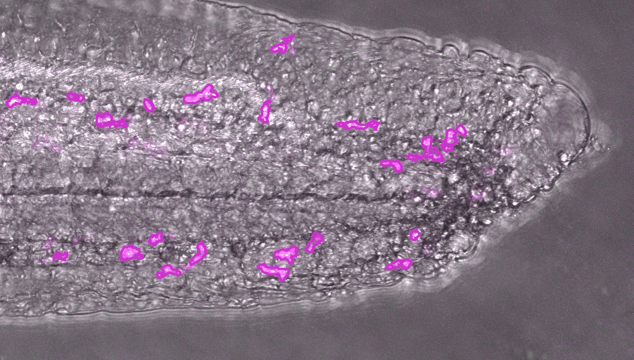
Image analysis in immunology
Immune cell trafficking in zebrafish tail
Ilkka Paatero

Slide 8

Image analysis in immunology
Immune cell trafficking in zebrafish tail
Quantitative measurements:
Displacement how far each cell moved,
Speed how fast they travel,
Directionality how persistent or random their movement is.
Ilkka Paatero

Slide 9
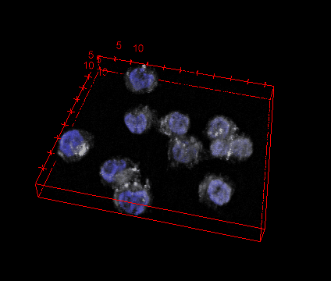
Image analysis in immunology
Protein quantification in immune cells
B-lymphoma cells
phospho-Btk
Nucleus
Saara Hämälistö

Slide 10
Contents
What is FIJI and where to get it
What is an image
How to view your images in Fiji
Look up tables
Channel management (split and merge, channels tool)
Sub-stacks, projections
How to check that your image has the right dimensions
Line measurement
Basic measurements (area, intensity, shape...)
Segmentation basics
ROIs and particle analysis
Binary operations

Slide 11


What is Fiji?
“Fiji is an image processing package — a "batteries-included" distribution of ImageJ, bundling many plugins which facilitate scientific image analysis.”
https://fiji.sc/

Slide 12

Check settings and install more Fiji Plugins
ImageJ was setup to analyse dark particles on white background, still causing issues during workflows. Most analysis these days is of fluorescent particles/organelles on black background. ImageJ needs to know whether to aggregate bright or dark pixels for particle detection!
Process... › binary... › options › “black background”
To enable additional Plugins, choose:
Help › Update…, then click the “Manage update sites” button.
Please activate the following update sites
IJPB-plugins
3D ImageJ suite

Slide 13
Common steps in image analysis
Image inspection
Filtering
Image measurements
Segmentation and binary operations
image processing
Image analysis
Extraction of useful information from microscopy images

Slide 14
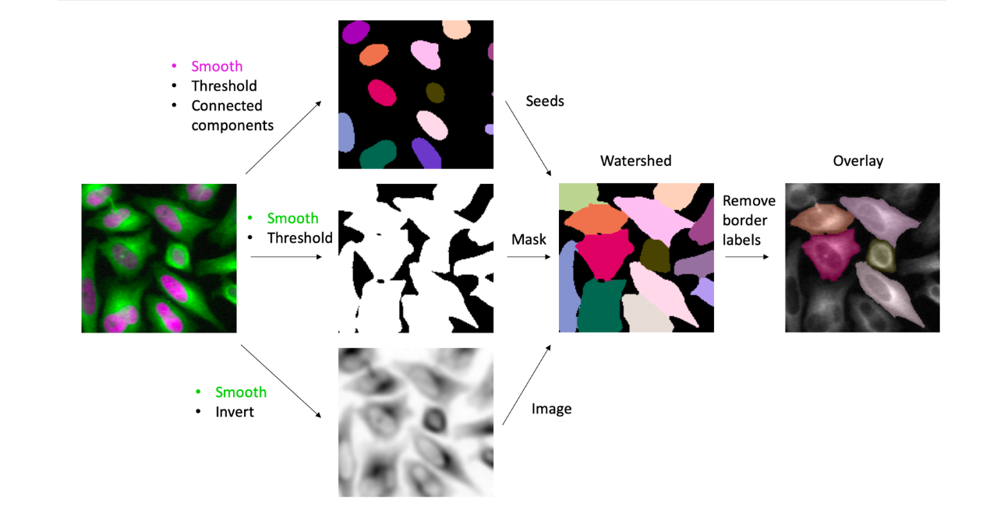
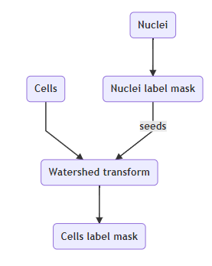
Image analysis pipelines

Slide 15
Common steps in image analysis
Image inspection
Filtering
Image measurements
Segmentation and binary operations
image processing
Image analysis
Extraction of useful information from microscopy images

Slide 16
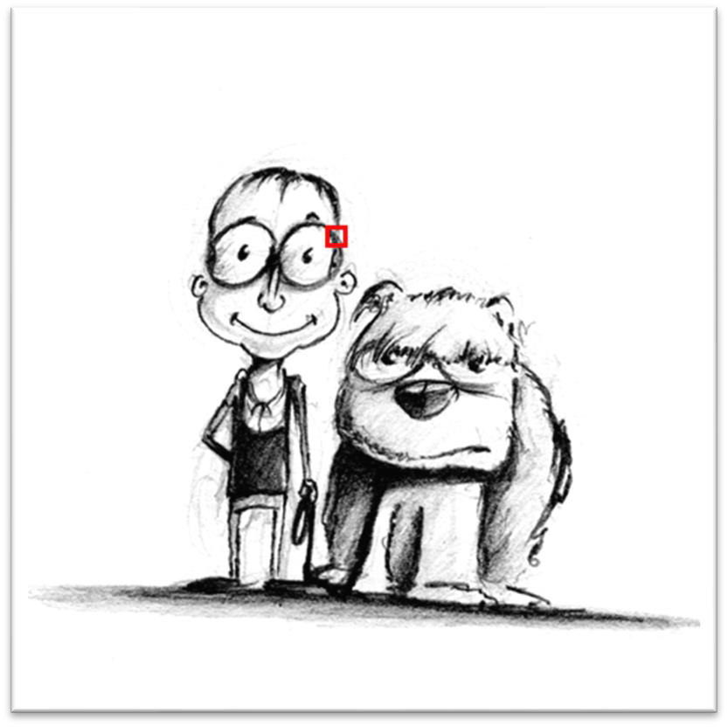
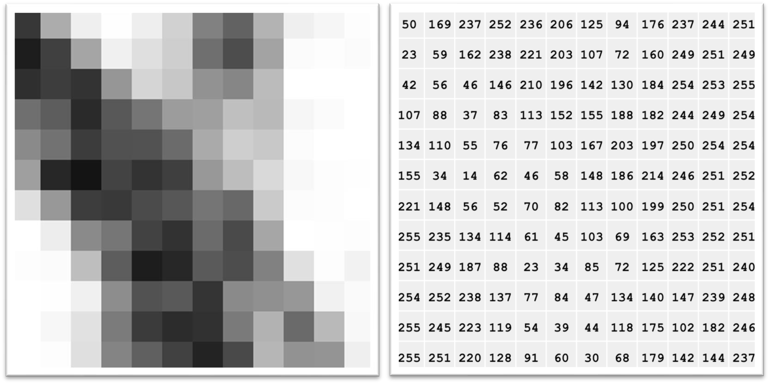
What is an image?
Original image
Enlarged image
Pixel values from 1-256
Introduction to bioimage analysis by Peter Bankhead
https://bioimagebook.github.io/ CC BY 4.0

Slide 17
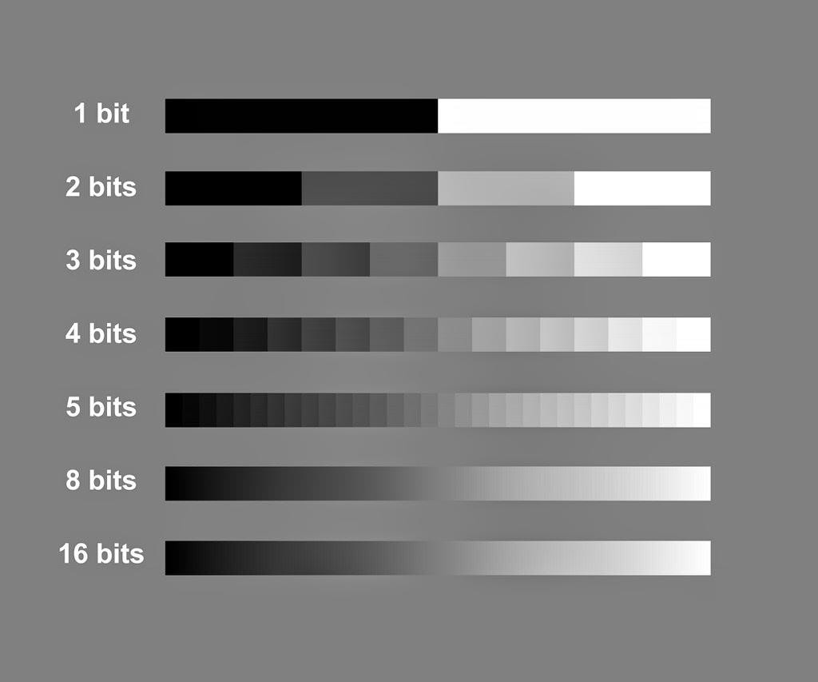
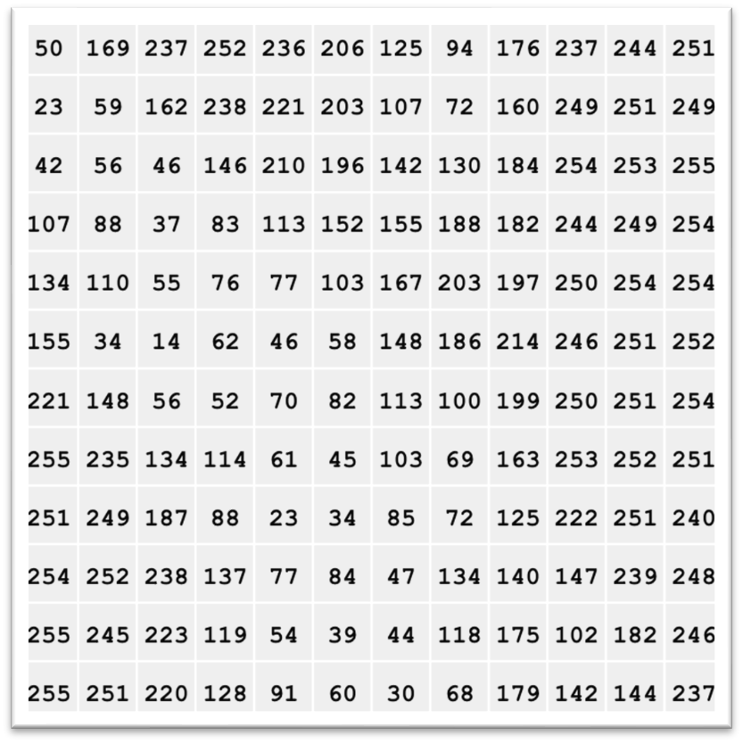
Bit depth
2
4
8
16
25
256
65536
Values from 1-256
Introduction to bioimage analysis by Peter Bankhead
https://bioimagebook.github.io/ CC BY 4.0

Slide 18
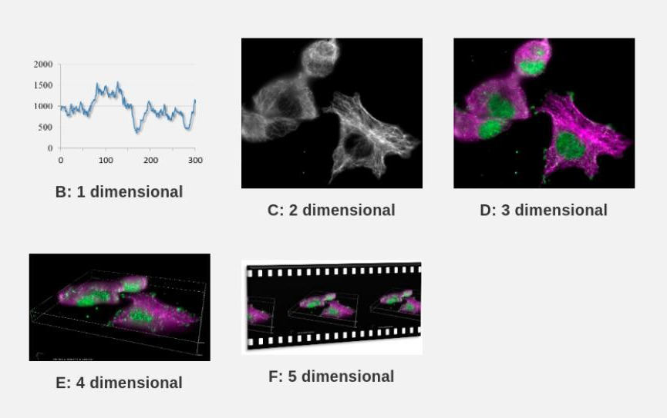
Image dimensionality
Introduction to bioimage analysis by Peter Bankhead
https://bioimagebook.github.io/ CC BY 4.0

Slide 19
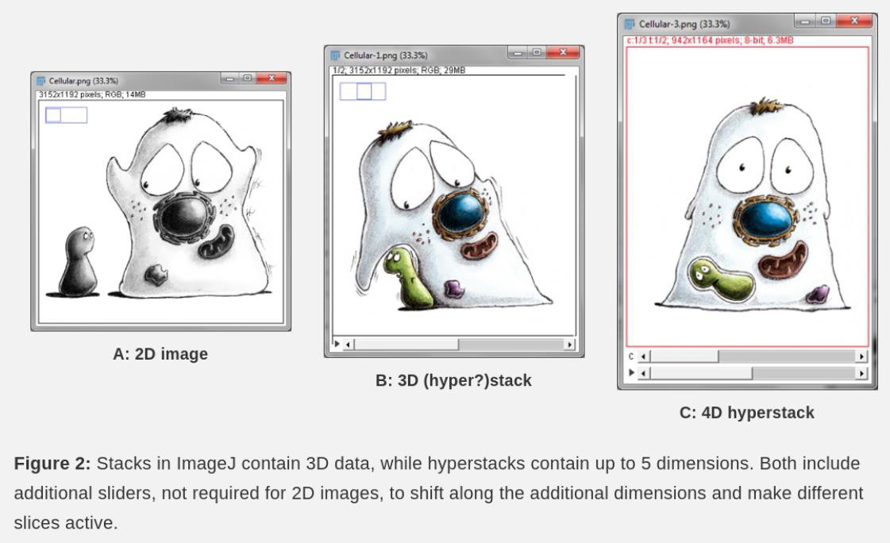
Image dimensionality
Introduction to bioimage analysis by Peter Bankhead
https://bioimagebook.github.io/ CC BY 4.0

Slide 20


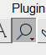

Let’s start exploring!
Open image and inspect
Open Fiji + image: Image1-composite-calibrated.tif
Pixels and bit depth, channels?
Zoom mouse right click + mouse left click –
Move around zoomed image use the hand tool
Adjust the contrast Image › Adjust › Brightness/Contrast
Channel management Image › Color › Channels Tool...
Split channels Image › Color › Split channels
Sync windows Analyze › Tools › Sync Windows

Slide 21
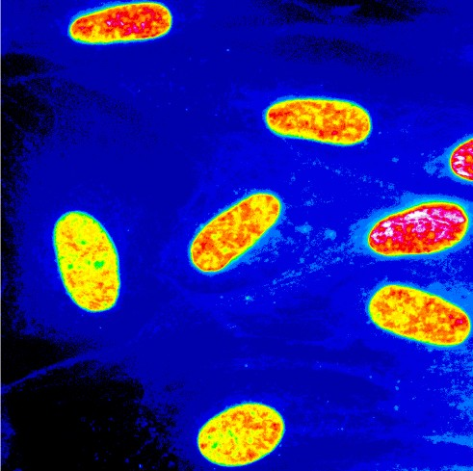
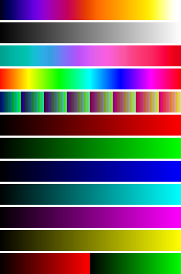
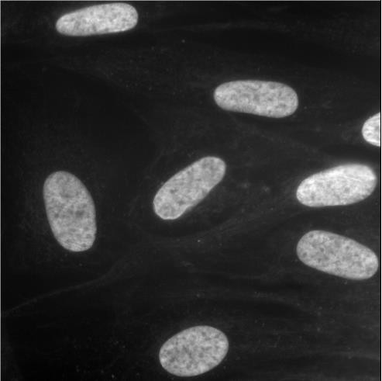
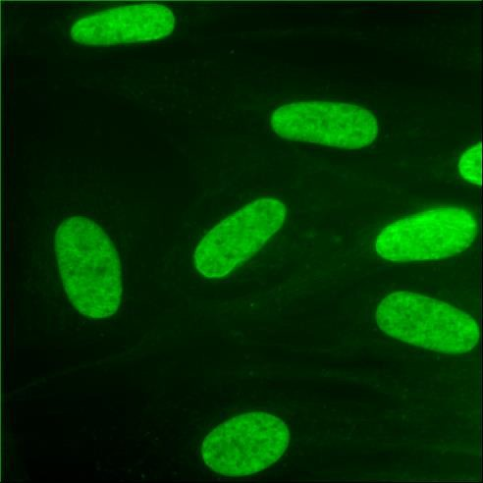
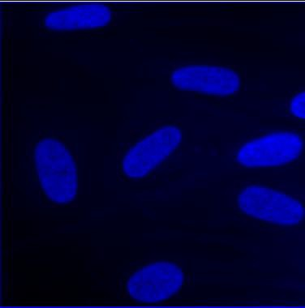
Look up tables (LUTs)
1 256
Try different LUTs Image -> Lookup tables

Slide 22
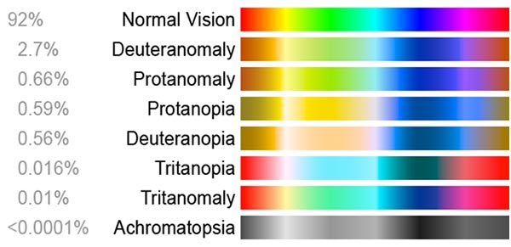
Channel merging
Merge channel
Image › Color › Merge channels
Further edit LUTs
Image › Lookup tables
Color blindness simulation
Duplicate: shift + D
Image › Type › RGB Color
Image › Color › Simulate Color Blindness
https://www.lenstore.co.uk/eyecare/your-guide-colour-blindness

Slide 23


N-dimensional images
Open sample image
File › Open Samples › Mitosis (5D stack)
OR Image7- mitosis
View different channels
Image › Color › Channels Tool...
Make a subset
Image › Duplicate... OR Ctrl + D and select wanted frames, channels, planes
Final image
Isolate one z-plane
Image › Duplicate... OR Ctrl + D
Make z-projection
(from original)
Image › Stacks › Z Project...
Crop image Choose rectangle tool:
draw region of interest
Ctrl + D
Original stack

Slide 24
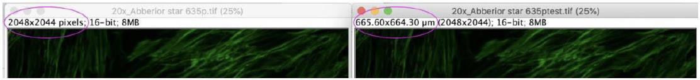
Image calibration
It is important that the image file is handled properly, and the size of the image calibrated, ImageJ doesn’t always read the files properly.
You can see if your image is calibrated from the from the info bar at the top of the image.

Slide 25
Image calibration
Image1-composite-calibrated.tif
Open image:
Check image properties
Image > Properties
Check that the number of channels, slices and frames match
Check your unit of length and set it to μm (um or micron) or nm
Check your pixel width and height (2D images the voxel depth can be ignored)

Slide 26
Common steps in image analysis
Image inspection
Filtering
Image measurements
Segmentation and binary operations
image processing
Image analysis
Extraction of useful information from microscopy images

Slide 27
Image filtering
Filtering can make segmentation much easier by enhancing features and reducing noise
Linear filters replace each pixel by a weighted sum of surrounding pixels (Gaussian, Mean)
Nonlinear filters replace each pixel with the result of another computation using surrounding pixels (Median)

Slide 28

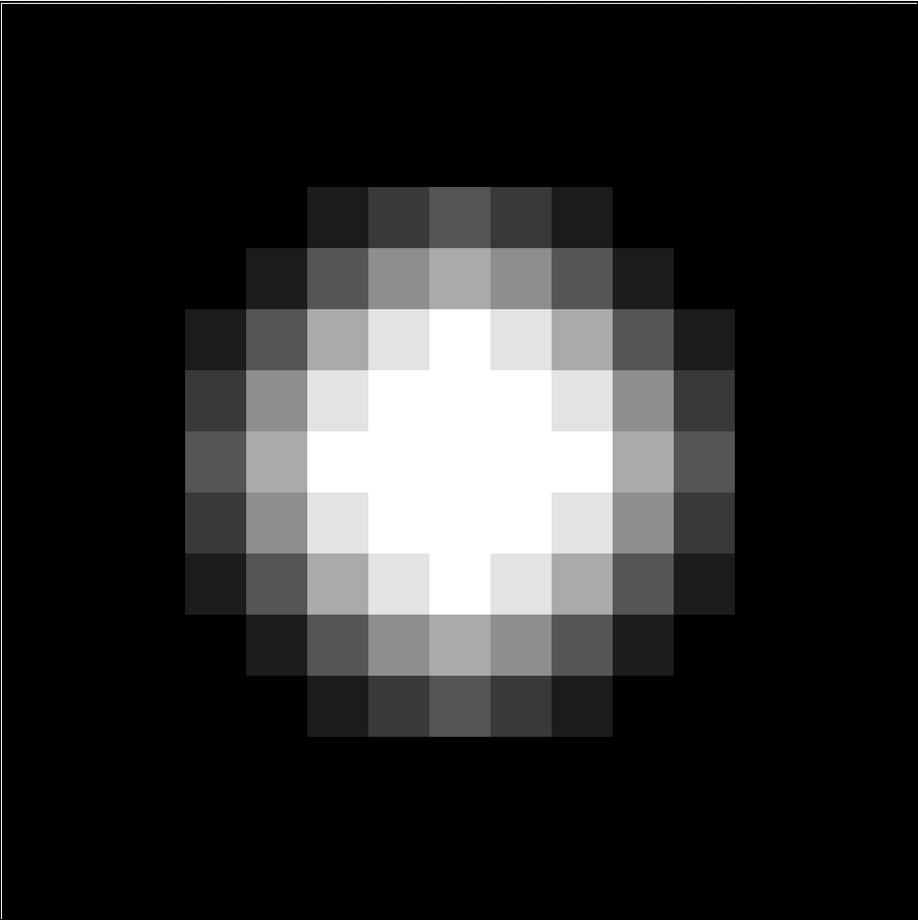
Linear filter demo
1
1
1
Open
Image13-blob.tif
1
1
1
Go to
Process > Filters > Convolve..
1
1
1
Sobel edge filter
Laplacian of Gaussian (LOG)
1
2
1
1
1
1
0
0
0
1
-8
1
-1
-2
-1
1
1
1
https://imagej.nih.gov/ij/docs/menus/process.html

Slide 29
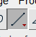
Noise reduction
Open image: Image3-nuclei_noisy
Duplicate your image: shift + D
In Fiji: Process › Filters…
Choose a filter to your liking (try more of you want!)
Choose the original image
Choose line tool and draw a line across the desired distance Analyze › Plot Profile
Select your filtered image and go Edit › Selection › Restore selection… And Analyze › Plot Profile

Slide 30
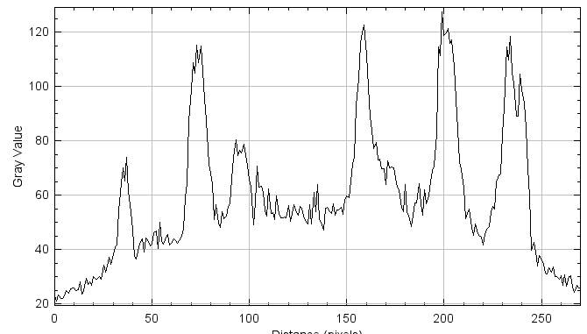
Correct uneven background
Open image: Image4-TH.tif
Duplicate your image: shift + D
Filters: Process > filters…
Method
Choose line tool and draw a line across the desired distance Analyze › Plot Profile
Subtract background using rolling ball Process > Subtract background..
Choose line tool and draw a line across the desired distance Analyze › Plot Profile

Slide 31
Common steps in image analysis
Image inspection
Filtering
Image measurements
Segmentation and binary operations
image processing
Image analysis
Extraction of useful information from microscopy images

Slide 32
Line measurement
To measure a distance in ImageJ, you can use the straight-line tool. Make sure that your image is correctly calibrated first.
Open image Image5-nuclei-high-contrast
Select the straight-line tool:
Draw a line across the desired distance
Read the length of the line below to ImageJ toolbar. You can also read the last coordinate of the line as well as the angle from the same place. To print the length, press m (measure)
To analyze the line profile: Analyze › Plot Profile
Try hitting live button, you can anow move the line
To print the line profile press

Slide 33
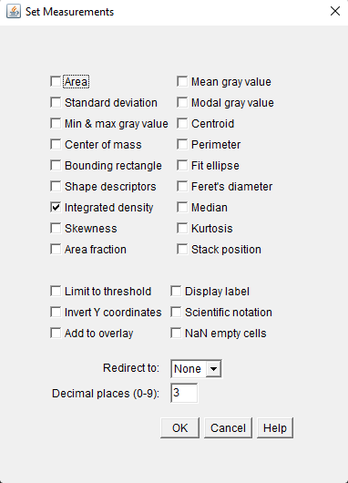
Basic measurements
Select measurements Analyze › Set Measurements...
Size - area, centroid, perimeter, Feret & “shape descriptors” (Circularity, Aspect Ratio, Roundness, Solidity)
Content - (gray values): mean, stdDev, minMax, mode…

Slide 34
Intensity measurements
Set the following measurements: Analyze › Set Measurements...
- Area
- Shape descriptors
- Mean gray value
Open images: Image5-nuclei-high-contrast and Image6-nuclei-low-contrast
Select images and measure one by one Analyze › Measure (or ctrlM)
What can you say about the results?

Slide 35
Common steps in image analysis
Image inspection
Filtering
Image measurements
Segmentation and binary operations
image processing
Image analysis
Extraction of useful information from microscopy images

Slide 36
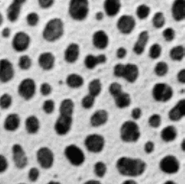


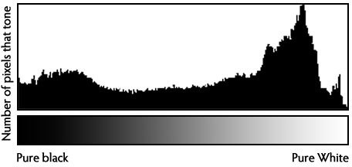
Segmentation
Image segmentation is the classification of pixels in an image as “pixels of interest” vs “background”
Separating a digital image into multiple segments.
Histogram based thresholding is the most common method to segment.
-> results in a binarized image
background
foreground
histogram

Slide 37
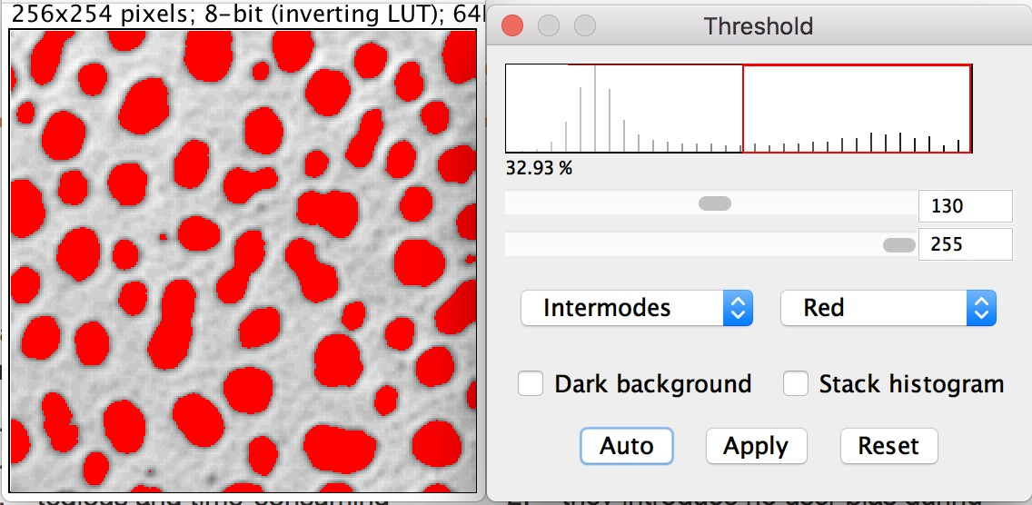
Manual thresholding vs. auto-thresholding
histogram
Manual methods have several limitations:
Benefits of Automated Segmentation
high user bias
no/low reproducibility
tedious and time-consuming fiddling-around
finding an "appropriate" cut-off value
incompatibility with automatic processing
high intra- and inter-user variability
no user bias during thresholding (algorithm selection bias?)
fully reproducible (on the same image they will always
lead to the same binarization result)
objectively determined cut-off values to minimize some variability in images being compared
they are fast (no fiddling) and can be automated

Slide 38
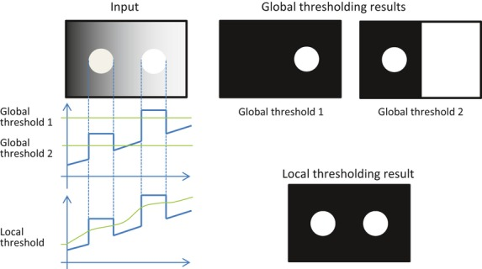
Global / local thresholding
Global thresholding
Chooses a general cut-off value for the whole image
Works well if all portions of the image have same quality, signal to noise/background, and all particles/objects have similar signal levels.
Local thresholding
Computed for each pixel according to the image characteristics within a window of radius r around it
Uchida et al. (2013).
CC BY 2.5

Slide 39
Segmentation
Which segmentation should I use? Try!
Open image: Image8-nuclei-high-contrast-crop
Image › Adjust › Threshold…
More information about global thresholding methods:
http://imagej.net/Auto_Threshold#Available_methods
Apply a threshold on your image: Image › Adjust › Threshold.. Choose your favorite
-> results a binarized image

Slide 40
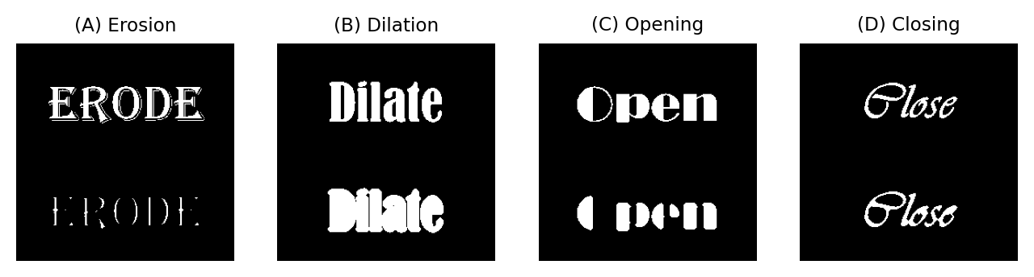
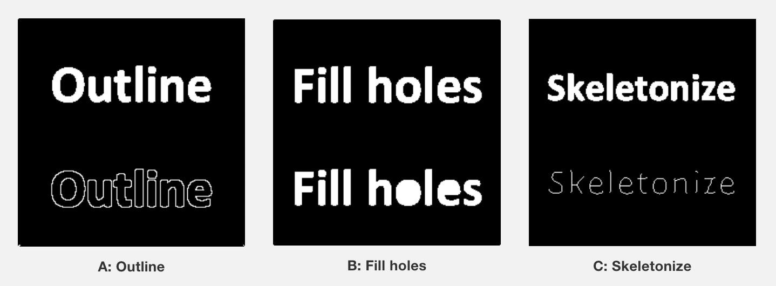

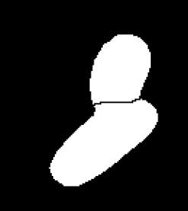
Binary operations
Dilate / Erode / Open / Close
Opening consists of an erosion followed by a dilation.
Closing consists of dilation followed by an erosion
image15_nuclei-low-contrast-binary
Process › Binary › Watershed

Slide 41
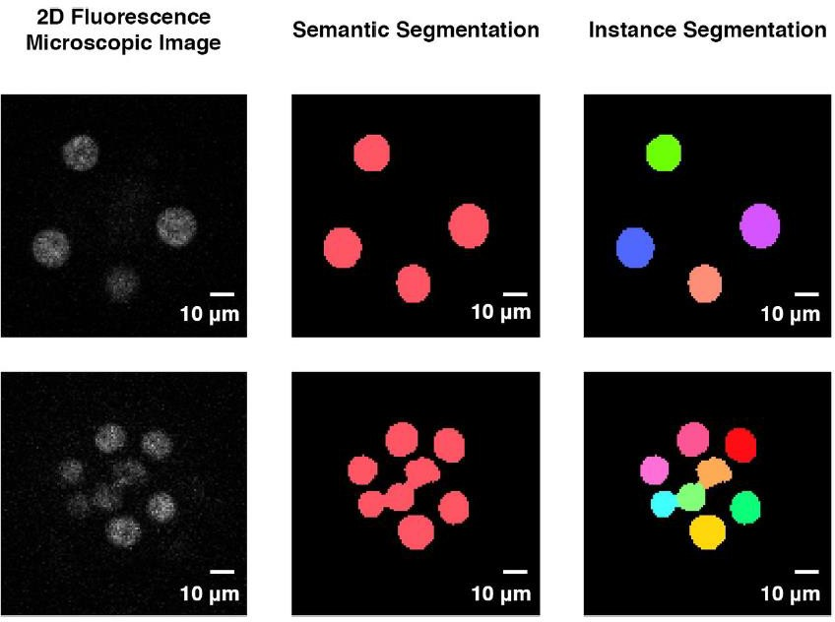
Binary Segmentation
Connected component labeling
Open image image16_nuclei-low-contrast-binary_watershed
Duplicate: shift + D
Plugins › MorphoLibJ › Binary Images › Connected Components Labeling
Learn more about MopholibJ here: https://imagej.net/plugins/morpholibj
0
255
0
255
0, 1, 2, 3……. XX

Slide 42
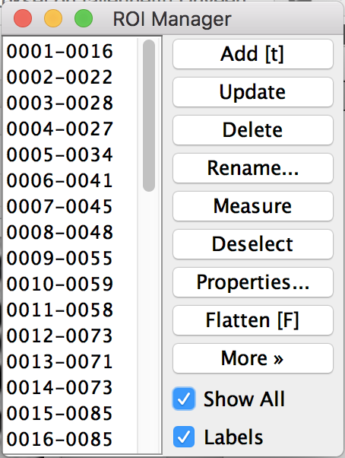
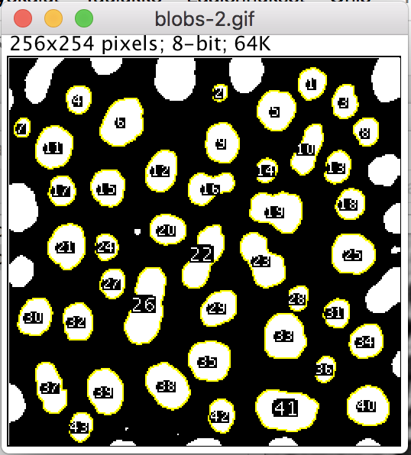
ROIs and particle analysis
Manual selections (=ROIs) are a (slow and biased) way to confine the measurements to organelles/compartments
In ImageJ/FIJI “particle analysis” is a technique to group adjacent pixels in individual ROIs that can then measured automatically as individual “objects” (connected component analysis)

Slide 43
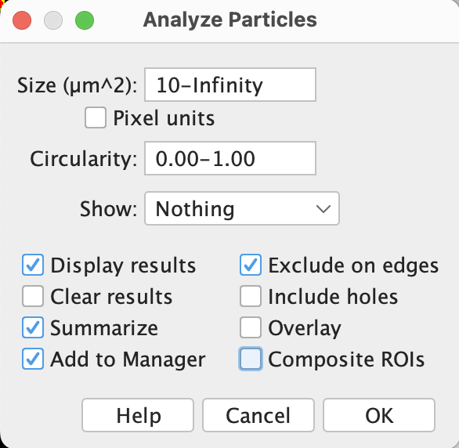
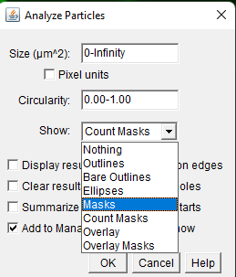
Analyze particles
Open image Image5-nuclei-high-contrast
Dublicate image shift + D
Set the following measurements:
Select your favourite threshold Image › Adjust › Threshold...
Analyze particles Analyze › Analyze Particles...
Analyze › Set Measurements...
Area
Shape descriptors
Mean gray value
Redirect to other channel

Slide 44
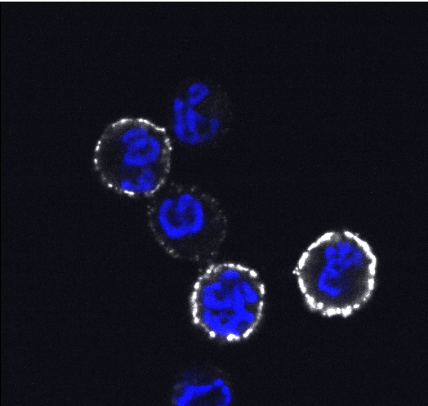
Exercise 1 – 3D analysis
Open images:
Image10-Blymphoma_activated_DAPI_pBtkGrey
Image11-Blymphoma_non_activated_DAPI_pBtkGrey
B-lymphoma cells activated
Activation marker pBtk is higher in activated cells
Images Saara Hämälistö
Notes:
The goal is to measure an activation marker, pBtk, which should be higher in activated cells.
This exercise will show how segmentation and measurement principles extend into 3D, same logic, but applied across z-stacks.

Slide 45
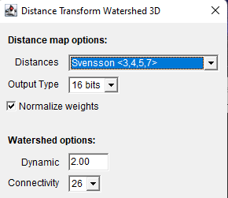
Exercise – 3D analysis
Examine by using brightness and contrast
1. Split channels and duplicate, close blue channel Image › Color › Split Channels
2. Pre-processing (filters)
Median 3D 5/5/5 Process › Filters › Median 3D...
Tophat 10 (don’t subtract) Process › Filters › Top Hat...
3. Detection (Threshold)
Mean, stack histogram Image › Adjust › Threshold...
4. Post-processing (binary)
Fill holes Process › Binary › Fill Holes
5. Post-processing (MorpholibJ)
Distance transform watershed 3D Plugins › MorphoLibJ › Binary Images › Distance Transform Watershed 3D
6. ROI management and measurement
Add image in 3D image suite Plugins › 3DSuite › 3D Manager
Select original image, Select all - quantify

Slide 46
